Slide 1
Defending Doctors In Adversarial Proceedings Continuing Legal and Medical Education V1.12
© Richard A Lawhern PhD, National Campaign to Protect People In Pain
December, 2025
For Legal Disclaimers, See Next Page
Defending Doctors in Adversarial Proceedings

Slide 2
Defending Doctors In Adversarial Proceedings Continuing Legal and Medical Education V1.13
Legal Disclaimers: This presentation is solely the work of Richard A. Lawhern PhD. It is a good faith effort to capture the state of legal and medical practice with respect to defending doctors and other clinicians in adversarial proceedings of courts and State medical/pharmacy/nursing boards. No State or Federal authority has formally accredited this course. Clinicians and lawyers must personally validate any information they take away from their viewing of this presentation. While the author is unaware of any remaining errors in this work, any and all uses of the information are solely at the discretion and the responsibility of the viewer.
The author and the distributing media company for this presentation have no legal liability for any application or use of this information. This presentation is licensed for single-user viewing for a fee based on 5 credit hours of continuing education. Individual charts or extracts may be re-published or referenced in open sources if attributed to the author and the distributing media company by name; however, no fee may be charged by any third party for such use of the material, save with the explicit authorization of the author in writing.
Defending Doctors in Adversarial Proceedings

Slide 3
National Campaign to Protect People In Pain About the Contributors
Principal Author: Richard A Lawhern, PhD, 28-year volunteer patient advocate and subject matter expert on public health policy in pain medicine and addiction; author or coauthor of >300 papers and articles in peer reviewed clinical literature and mass media.
Contributing Subject Matter Experts:
Ashley Rogers cppadvocate2831@yahoo.com Chronic pain patient and advocate in Pennsylvania
Barby Ingle barby@internationalpain.org Pain patient, author and VP of the International Pain Foundation. Jay Joshi MD jjoshi45@gmail.com Board certified pain management clinician and publisher, Daily Remedy.
Andrea Trescot MD, DrTrescot@gmail.com Past President, American Society of Interventional Pain Physicians
Jonelle Elgaway jelgaway@gmail.com Executive Director, National Pain Council
Joseph Parker MD ljparkermd@gmail.com Board certified pain clinician, widely published healthcare writer
Kristen Ogden kristendogden@gmail.com Patient advocate in Virginia and litigant in actions to defend a California doctor from DEA persecution.
Lawrence Peskin, PhD, JD, lfpeskin@gmail.com, Pain psychologist, Attorney
Monty Goddard, PE, MSCE, montygoddard@msn.com Pain patient caregiver, patient advocate in California. Mark Ibsen MD markmusheribsen@gmail.com 35 years in emergency medicine. Defendant in a multi-year
unfounded persecution by the Montana Medical Board
Pat Irving M.Ed., RN dirving@sonic.net Chronic pain patient and former National Leader for patient safety and risk education for the Kaiser Permanente. SME on National Opioid Settlement.
Stephen Nadeau MD stephen.nadeau@neurology.ufl.edu 42 years behavioral neurologist and pain specialist. Professor of Neurology, University of Florida College of Medicine.
Defending Doctors in Adversarial Proceedings

Slide 4
Defending Doctors In Adversarial Proceedings - Intended Audience -
Defense Lawyers
Expert Witnesses for the Defense
Clinicians
Physicians,
Physician Assistants,
Nurse Practitioners,
Nurses
Others licensed to treat pain or to prescribe pain relievers
Patients and Caregivers
Defending Doctors in Adversarial Proceedings

Slide 5
Defending Doctors In Adversarial Proceedings - Course Outline -
Understanding Context – The Opioid “Crisis”
Before You Are Charged – Steps to Reduce Your Exposure
Pre-Trial Preparation, Motions and Daubert Challenges
Opening Arguments
Burdens of Proof and Understanding the Evidence
Closing Arguments
Notes on Appeals Process
Literature References
90+ charts, 80+ references – 5 online course segments
Defending Doctors in Adversarial Proceedings

Slide 6
Course Objectives for Doctors, Lawyers and Witnesses
Avoid adversarial proceedings if possible.
Understand arguments in defense of doctors - or patients - in adversarial proceedings
Understand current legal contexts for defending doctors
“The Opioid Crisis in Three Charts” – as presented in an FDA listening session July 2024, and to the Office of the NIDA Director in October 2024
Many additional sources and legal precedents
Understand principles from the clinical and legal literature
Understand what qualifies – or disqualifies – government or defense “expert witnesses”
Understand published data on accidental drug mortality and risk
Applicable to both court proceedings and State Boards
Course text in red is especially important
Defending Doctors in Adversarial Proceedings

Slide 7
Course Objectives -2-
Help doctors avoid adversarial proceedings if possible
If proceedings are unavoidable, lawyers and doctors can prepare themselves and defense witnesses to be effective
Defeat prosecutors and educate judges or Boards so cases are decided on fact not bias
Identify pre-trial exhibits for Board proceedings and points of argument or testimony for court proceedings
Help lawyers win cases and build their reputation and practice
Defending Doctors in Adversarial Proceedings

Slide 8
Avoiding Adversarial Proceedings
Defending Doctors in Adversarial Proceedings

Slide 9
About Clinical Record Keeping
Good record keeping might stop adversarial proceedings before they start
Patient Records (permanent retention on-site and OFF!)
Case notes (hard copy and electronic)
Recommended course of treatment (patient-doctor agreements)
PDMP reports
Referral reports from other clinicians (initial or during patient treatment)
Voice and/or Video Recordings (with patient permission)
AI-based Voice-to-Text Interview Agents
Practice EMPLOYEE Records
Application for employment, with certifications and license checks
Arbitration agreements for employer/employee disputes
Employee performance evaluations
Actions to terminate for cause
Records of State Boards or Law Enforcement
Your license to prescribe; DEA license; Board certifications
Probationary actions by State boards
CME records -- establish that you have remained current.
Defending Doctors in Adversarial Proceedings

Slide 10
About Clinical Record Keeping -2-
Every Practice Needs a Law Firm
… and this course may help lawyers defend you.
Some Practices May Need a Private Investigator
Detect Sham Patients employed by US DEA
Research past cases won or lost by your law firm
Research past cases tried by the presiding judge
Defending Doctors in Adversarial Proceedings

Slide 11
About Clinical Record Keeping -3-
A further dimension of “record keeping” is for clinicians to find and read their own State prescribing and treatment guidelines.
You should also know the date of those guidelines.
Guidelines should be available on the website of your State Medical Board
Alternately, you can find the current version at http://Perplexity.ai
Defending Doctors in Adversarial Proceedings

Slide 12
Context of Adversarial Proceedings Problems, Realities, Legislative Solutions 2024 Briefings to Senior FDA and NIDA Officials
Defending Doctors in Adversarial Proceedings

Slide 13
The Real US Opioid Crisis – Problems Presentation to US FDA/CDER, July 23, 2024
Deserted patients are dying of medical collapse & suicide.
Community clinics are refusing new patients for pain management, force-tapering legacy patients off opioid therapy or discharging them
Over-regulated pharmacies are denying medically necessary prescriptions to desperate patients
Major artificial shortages of controlled drugs are being caused by National Opioid Settlement
American pain medicine has been criminalized by Federal and State intrusion.
CDC, Veterans Administration and State “prescribing guidelines” are based on political agendas, not science.
DEA is driving doctors out of practice, fearing sanctions or prosecution for “over-prescribing” pain relief.
Some doctors are being railroaded into prison by malicious prosecution.
Defending Doctors in Adversarial Proceedings

Slide 14
The Real Opioid Crisis - Realities Presentation to US FDA, July 23, 2024
Patients receiving adequate pain treatment with opioids are functioning, productive members of society. When pain is undertreated, they suffer inhumanely and become disabled.
The real US opioid crisis is dominated by street drugs, not prescriptions of doctors to their patients.
Risk of opioid addiction or overdose in medical patients is too low to measure accurately.
The best predictor for overdose or suicide risk in medical patients is a history of severe mental health problems – not opioid prescription type, dose or duration.
US CDC and VA prescribing guidelines ignore these realities.
DEA prosecutors target prescribers, ignoring these realities – long known to the Agency – penalizing practices fully authorized by FDA.
Defending Doctors in Adversarial Proceedings

Slide 15
The Real Opioid Crisis – Legislative Solutions Presentation to US FDA, July 23, 2024
Repeal or amend Controlled Substances Act of 1970.
Rescind DEA authority to set production quotas of scheduled drugs
Stop pre-trial asset seizures, coercion of doctors and employees, paid testimony by unqualified or plea-bargained “expert” witnesses
Eliminate “red flag” restrictions not mandated by law or published regulations
Implement SCOTUS ruling in “Ruan vs. United States”
Restrict DEA mission to interdiction of illegal drug importation or manufacture
Repeal “Injunctive Relief” clauses from National Opioid Settlement
Abolish bureaucratic over-regulation and prescribing thresholds
Repeal Veterans Administration Mission Act of 2019
Repudiate and withdraw CDC, VA opioid guidelines
Return oversight of medical professionals to State Medical Boards in non-judicial proceedings.
Major National funding is needed for new trials of prescription drug safety, effectiveness, and side effects
Protocols addressing effects of genetically mediated drug metabolism
Defending Doctors in Adversarial Proceedings

Slide 16
Consequences: Horrifying Examples
Patients denied pain care sometimes commit suicide
“ ‘Entire Body Is Shaking’: Why Americans With Chronic Pain Are Dying” (January 2023)
“After a Crackdown on a Pain Clinic, a Tragic Double Suicide” (December 2022)
Her husband died by suicide. She sued his pain doctors — a rare challenge over an opioid dose reduction (November 2021)
“UAB team investigates suicide, opioid prescription changes” (November 2020 and continuing)
Defending Doctors in Adversarial Proceedings

Slide 17
Beyond the Context Understanding the Principles
Defending Doctors in Adversarial Proceedings

Slide 18
Principles of Adversarial Proceedings
Court cases and Board proceedings are different
In Board proceedings, clinical literature can be submitted to support Doctors’ arguments.
In court proceedings, jurors will not be allowed to read documents and judges might not choose to; witnesses must inform juries.
Proceedings involving arbitration courts may be preceded by affidavits executed by patient complainants’ expert witnesses.
Lawyers and subject matter experts must present the evidence in language understandable to judges and/or jurors with a 6th grade education and an IQ of 100.
In Board adversarial proceedings, Board members appointed without medical training are at a severe disadvantage.
They aren’t any doctor’s “peers.”
To bring them up to speed, weeks of reading may be required.
It may be in order to suggest that Board members without appropriate clinical training should recuse themselves.
Defending Doctors in Adversarial Proceedings

Slide 19
If You Are Raided
Some clinicians report being raided by armed agents of DEA, DoJ, or State Law Enforcement
Tactics can border on intimidation and assault
Gestapo-like tactics may be directed at clinicians, staff, AND patients
If you are raided:
Demand to see and read a detailed warrant
Demand to have your lawyer present
Under no circumstances volunteer information to agents
Reassure your patients and staff. Encourage them to make notes on what they see during the raid
Defending Doctors in Adversarial Proceedings

Slide 20
Beginning Adversarial Proceedings
Pre-Trial Motions
Defending Doctors in Adversarial Proceedings

Slide 21
Daubert Challenges
Pre-Trial Motions may be used to disqualify expert witnesses
1993 U.S. Supreme Court case Daubert v. Merrell Dow Pharmaceuticals, established new standards for admitting expert testimony in federal courts.
Pretrial motions to exclude or limit an expert’s testimony.
Purpose is to ensure that expert testimony presented to a judge or jury is based on reliable scientific methodology and is relevant to the case at hand.
Focus on reliability and relevance of the expert’s testimony, not just qualifications.
Applies to both civil and criminal cases in federal courts and many state courts.
Defending Doctors in Adversarial Proceedings

Slide 22
What Makes a “Subject Matter Expert?”
Expert Witness Requirements (Rule 701, 702 and 703)
- Clinicians qualified by knowledge, skill, experience, training, or education in a relevant medical field (including Internal Medicine). - MDs, and other clinicians -- current, valid, and unrestricted medical license. - Board Certified in an appropriate specialty - Testimony based on sufficient facts or data - Demonstrating application of reliable principles and methods
- Result of reliably applying principles and methods to the facts of the case - Expert must review all relevant medical information fairly and honestly - Distinguish between actual negligence or misbehavior versus unfortunate medical outcomes - Base testimony on personal experience, clinical references, or evidence-based guidelines - Receive reasonable compensation not linked to the case outcome - Non-clinician experts should possess specialized knowledge that will help the trier of fact understand the evidence or determine a fact at issue * - Appropriate education - Record of publications under peer review or editor review
- Record of wide exposure to critical oversight by other experts - Record of professional awards or acknowledgments of performance - Service on editorial boards or invited public panel discussions
* Suggested by the Course Author
Defending Doctors in Adversarial Proceedings

Slide 23
What Might Disqualify “Subject Matter Expert” Witnesses?
Education in “principles” divorced from clinical practice or science
- Academicians may lack hands-on experience with similar patients.
Testimony unrelated to the issues in contest
Lack of published peer-reviewed papers cited by other experts
Clinical practice primarily in fields other than those involved in the proceeding
Generalizations without verifiable references – or in dated or discredited sources (notably CDC or VA opioid guidelines)
Major income from testimony against doctors - Financial incentive to misrepresent facts to obtain convictions
Testimony of former employees or criminal defendants - Coerced testimony or incentives for perjury or worst-case interpretations
Defending Doctors in Adversarial Proceedings

Slide 24
Criteria for Disqualifying Clinician Witnesses -2-
A clinician isn’t an “expert” on medical literature unless they ALSO understand its pertinent weaknesses
Replication “Crisis” – Many trials or study results don’t duplicate if performed to the same procedures by different investigators.
Even if repeated outcomes are similar, strength of findings is often reduced.
Peer review process is compromised by reviewer and editor bias.
Publish or Perish – Authors repeat popular falsehoods to get into print
Cherry picking interpretations of results to support author opinions
Negative results are rarely reported
Prevailing mythologies are left in place to later produce mischief
Expectation bias – investigators see what they expect to see, and fail to cross-check methods or original data sources thereafter
Defending Doctors in Adversarial Proceedings

Slide 25
A New Criterion for Disqualifying Clinician Witnesses
Failure to Understand Clinical Trial and Study Protocols
An anecdote: In a 2022 medical conference before 100+ doctors and nurse practitioners, the speaker asked a question for a show of hands: “How many of you have recent training in the evaluation of clinical trials and study protocols?”
No hands went up.
As the speaker suggested to the audience, “You realize, of course, that without this exposure, when you read only the abstract of a published clinical paper, you have no idea whether the authors or peer reviewers knew what they were doing. You lack the skills to check their work.”
You could have heard a pin drop as the lecture continued.*
* Many courts, witnesses and juries also lack the skills to check witness assertions. This is your job as attorneys!
Defending Doctors in Adversarial Proceedings

Slide 26
Pre-Trial Discovery
Defending Doctors in Adversarial Proceedings

Slide 27
Process of Discovery
Prosecutors are required to disclose in pre-trial discovery all evidence and information in their possession or control that is material to the defense or relevant to the case.
Any evidence or information that tends to negate the guilt of the accused or mitigate the offense charged.
Exculpatory evidence or information that could reduce the punishment of the accused.
Tangible objects, documents, reports of examinations and tests that the prosecution intends to use at trial.
Written or recorded statements or confessions made by the defendant.
The substance of testimony the government expects from expert witnesses.
Prior criminal records of the defendant, if relevant.
Information that could impeach government witnesses or evidence.
Any additional evidence discovered before or during trial that is subject to discovery rules.
Defending Doctors in Adversarial Proceedings

Slide 28
Process of Discovery -2-
Clinicians are required to disclose: training and credentials: licenses, board certifications, DEA registration, hospital privileges, and documented pain‑management training or CME.
Prior complaints and discipline: grievance or complaint history, prior malpractice claims or settlements, and disciplinary actions, especially those involving prescribing or substance‑use issues.
Personnel and credentialing files: performance reviews, privileging/ credentialing documents, quality‑assurance findings, and any records showing concerns about clinical competence, prescribing patterns, or impairment, subject to peer‑review and similar privileges.
Substance‑use or impairment information: if the plaintiff alleges that impairment (e.g., substance use disorder) affected care, courts have allowed discovery of some medical or mental‑health information to the extent it is directly relevant to that allegation, often with protective orders to safeguard privacy.
Defending Doctors in Adversarial Proceedings

Slide 29
Adversarial Proceedings Opening Arguments
Defending Doctors in Adversarial Proceedings

Slide 30
Opening Arguments for Defense Lawyers
Defense will argue that:
Defendant harmed nobody
Defendant’s practice of medicine reflected highest prevailing consensus standards
CDC and VA prescribing guidelines are not consensus standards
Controlled Substances Act identifies prescribing “outside the usual course of professional medical practice and without a legitimate medical purpose” as a criminal offense – without defining what practices are authorized or by whom.
21 C.F.R. § 1306.04(a). provides that, “to be effective,” a prescription “must be issued for a legitimate medical purpose by an individual practitioner acting in the usual course of his professional practice.”
Alleviation of pain and promotion of quality of life are always “legitimate” medical purposes.
Prosecution expert witnesses are not truly “experts”
Prosecution doctors don’t “know” what they think they do
Law enforcement agents are poorly trained and misinformed but operate with “gotcha” mindset that forces the most negative interpretations on normal clinician practices
Some prosecution witnesses have incentives to misinterpret or outright lie
Financial self-interest of professional witnesses for the government
Employees coerced by threats of prosecution
Criminal offenders motivated by plea bargaining agreements
Defending Doctors in Adversarial Proceedings

Slide 31
Opening Arguments -2-
Defense may further argue that:
Sometimes bad things happen to good people and it’s nobody’s fault.
In any medical practice, some patients die for unrelated reasons.
Relatives’ complaints may not always be accurate.
Before depriving any defendant of liberty or their income, prosecutors must prove beyond a shadow of doubt that defendant.
actually did something wrong, dangerous or unprofessional.
knew it was wrong when they did it.
Revoking a doctor’s license or placing them on probation for minor record keeping issues that do not endanger patients is ludicrous!
“Dr X did so-and-so, that I would not have done” is not enough to justify depriving a defendant of their income or freedom.
Convictions cannot be based on innuendo or generalizations.
Defending Doctors in Adversarial Proceedings

Slide 32
Opening Arguments -3-
The Defense may need to present and explain clinical science and public health policy – including problems therein.
“In the coming days and during your deliberations, Defense will ask you to consider some complex facts from medical knowledge and clinical practice”.
“These facts aren’t trivial – the defendant’s future life and livelihood may depend on what you learn in these proceedings.”
“Defense witnesses will help you to understand important points and separate fact from fiction.”
“There’s a lot of fiction running around these days – and the prosecution might try to make you believe some of it.” *
It’s Amazing How Much of What ‘Everybody Knows’ Ain’t So!
* Use your own judgment on requirements of professional courtesy -- and research the Judge before the case is tried. [or have your PI do so]
Defending Doctors in Adversarial Proceedings

Slide 33
“Exceptions” During Court Proceedings
An “exception” is a formal way for a party to object to a court’s ruling or to challenge a defect in the other side’s pleadings so the issue is preserved and can be reviewed later on appeal.
In traditional practice, an exception is a formal objection to a judge’s ruling, used to signal that the party disagrees with the decision and wants to preserve that alleged error for appellate review.
Many modern rules now allow a simple, timely “objection” to serve the same function without requiring a separate, technical “exception.” But the underlying idea —documenting an asserted error — remains the same.
Defending Doctors in Adversarial Proceedings

Slide 34
“Exceptions” During Court Proceedings -2-
Exception to rulings
When a judge overrules an objection or issues an adverse ruling, a party may “take exception” to make clear that the party does not acquiesce in the ruling. Properly noting that exception (or objection, under modern rules) ensures the issue is recorded in the minutes or transcript so an appellate court can later review whether the ruling was legally correct.
Reference: https://www.upcounsel.com/bill-of-exceptions
Defending Doctors in Adversarial Proceedings

Slide 35
Adversarial Proceedings Between Patients and Insurance Companies
Arbitration courts are also “adversarial proceedings”
Disputes between patients and health insurance companies may be subject to binding arbitration.
Harms are done to patients due to insurance company practices.
Arguments before arbitration courts may require preliminary briefs by claimants and responders.
Arbitrator determines if court proceedings are warranted versus summary judgment for claimant or respondent.
Arguments strongly parallel those before State Boards
Defending Doctors in Adversarial Proceedings

Slide 36
Adversarial Proceedings Between Patients and Insurance Companies -2-
Insurance Company expert witnesses can be disqualified
Avoid impugning professional reputations
A doctor may believe they are testifying to prevailing standards of care and still be wrong.
CDC and Veterans Administration prescribing guidelines are not accepted consensus “standards of care”.
Acknowledge ambiguity: patients or caregivers in stressed circumstances are not “perfect” witnesses and neither are clinicians.
Be especially aware of the impact of metabolic genetics – many doctors aren’t.
Defending Doctors in Adversarial Proceedings

Slide 37
Adversarial Proceedings Between Patients and Insurance Companies -3-
Defense should focus on sources of expert authority
Any reference to CDC opioid prescribing guidelines may be disqualifying for a prosecution witness (on grounds addressed herein).
Details of practitioner risk vs. benefit analysis may also be challenged if the expert has been trained by CDC, FDA (REMS) or DEA
Involuntary taper without referral for effective pain control is never under any circumstances medically ethical
Requests for better pain control are not a red flag for “drug seeking”
Defending Doctors in Adversarial Proceedings

Slide 38
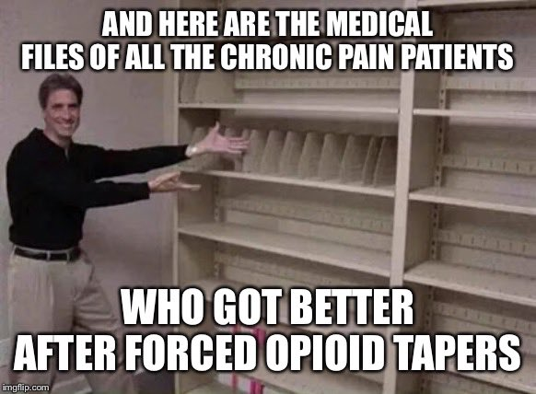
A Powerful (and Accurate) Meme
Defending Doctors in Adversarial Proceedings

Slide 39
Understanding Prescribing Guidelines (Separating Truth from Fiction)
Defending Doctors in Adversarial Proceedings

Slide 40
CDC and VA Opioid Prescribing Guidelines - Major problems with science [*]
CDC and VA 2022 Guidelines Are Not Consensus Documents
Misrepresentation and Cherry Picked Research
Morphine Milligram Equivalent Dose Metrics = Junk Science
Gross Over-Emphasis on Prescribing Risks
Dangerous Emphasis on Forced Tapering
Failure to Address Genetics of Opioid Metabolism
Reliance on CDC/VA Guidelines Strongly Indicates an Unqualified Witness
Reliance on DEA and Board investigators… has the same issues
* Expanded in Charts to Follow
Defending Doctors in Adversarial Proceedings

Slide 41
CDC / VA Guidelines -1- Misrepresentation of Research
Faulty methods in key Guideline references
Inappropriate generalizations from single-shot trials to chronic pain treatment
Opioid effectiveness trials dominated by acute pain in dental practice – but generalized to other chronic pain
Meta-analyses combining poor-quality studies – affected by the GIGO law
Asserted “thresholds” above which benefits of opioids are considered doubtful
BUT no specific references quoted from literature
Alternatives to opioids recommended by CDC as “preferred”…
BUT no published trials compare opioids with non-drug therapies on an either/or basis
Methodology in over 5,000 published trials is abysmal
Improvements in pain levels when non-opioid therapies are added, are short-term and marginal (~2 points on a scale of 0-10)
NSAIDs also have significant hazards, unremarked by CDC but known widely to clinicians.
Defending Doctors in Adversarial Proceedings

Slide 42
CDC/VA Guidelines -2- Unscientific Morphine Milligram Equivalent Dose Metrics
Morphine Milligram “Equivalent” Dose is junk science
Based on 30-year-old opinion paper by two clinicians plus limited small trials
Multiple math models generate different estimates
AMA is on public record that use of MMED to limit treatment has harmed patients
However, MMED was the central “metric” used by CDC/VA guidelines as a basis for healthcare policy
Defending Doctors in Adversarial Proceedings

Slide 43
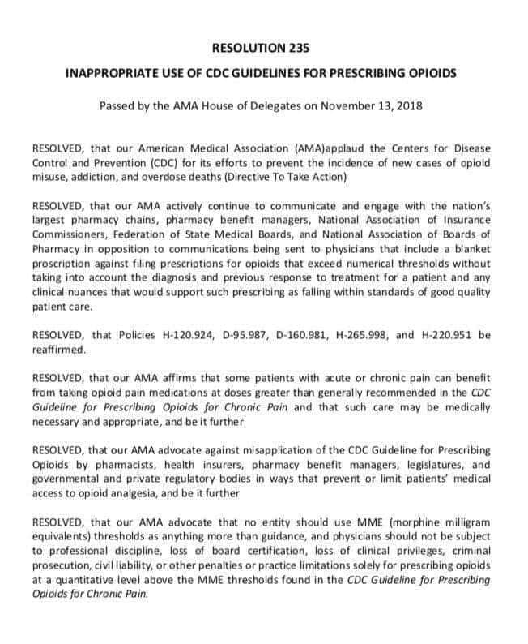
CDC/VA Guidelines -2A- AMA Position on Misuse of MMED
Defending Doctors in Adversarial Proceedings

Slide 44
CDC/VA Guidelines -3- Gross Over-Emphasis on Prescribing Risks
“Risk” appears over 400 times in CDC Guidelines.
Clinicians are directed to perform and repeat risk-versus-benefit analyses for their patients.
BUT: no validated risk analysis tools were provided or referenced.
Thus clinicians are effectively on notice that they are at risk if they prescribe…
To any patient
For any reason
At any dose
Multiple published sources deeply contradict CDC recommendations and reveal fatal errors
Defending Doctors in Adversarial Proceedings

Slide 45
CDC/VA Guidelines -4- Dangerous Emphasis on Forced Tapering
“Taper” means to reduce medication dose either voluntarily or involuntarily.
“Taper” appears 50+ times in 2022 CDC guidelines
Taper for any reason is associated with increased risk of medical crisis or overdose
Non-consensual taper is medically unethical
300+ clinicians and subject matter experts went on record in 2019 to challenge CDC on tapering policy
Defending Doctors in Adversarial Proceedings

Slide 46
Recent CDC Back-Peddling
“Healthcare Administrators: Applying the Guideline”
“Health systems are encouraged to review pain management policies and standards and consider updating them…”
“Avoid misapplying the 2022 Clinical Practice Guideline by developing policies and standards that are inconsistent with its purpose or go beyond its intended use…”
“Do not set rigid dosage thresholds. Payers and health systems should not use the 2022 Clinical Practice Guideline to set rigid standards related to dosage or duration of opioid therapy.”
“The Guideline is not a replacement for clinical judgment or individualized, patient-centered care. It is intended to be a flexible clinical tool.”
Defending Doctors in Adversarial Proceedings

Slide 47
CDC/VA Guidelines -5- Failure to Address Genetics of Opioid Metabolism [*]
Minimum effective opioid dose and sensitivity to side effects vary widely between individuals
25-year clinical literature ignored by CDC and VA
Opioid metabolism is mediated by genetics of CYP-450 series liver enzymes
25% of US population are poor metabolizers or “hyper” metabolizers
Estimated range in minimum effective dose ~15-to-1
The entire clinical literature of opioid safety and effectiveness must be recalled and done over
Many other fields of medicine are impacted
Meanwhile, clinicians must depend on hands-on experience from internships or fellowships and patient observation
[*] “Opioid Prescribing Guidelines Ignore Metabolism”, KevinMD.com, November 7, 2025
Defending Doctors in Adversarial Proceedings

Slide 48
CDC/VA Guidelines -5A- Failure to Address Genetics of Opioid Metabolism (2)
50-60 percent of prescription drugs that undergo metabolism are metabolized in the human liver.
The liver’s cytochrome P450 enzyme system is responsible for metabolizing half or more of all clinically relevant medications.
Only a small percentage of drug trials attempt to address variable metabolism between patients
Adverse Drug Events are now the third leading cause of death in America, surpassing deaths from stroke and respiratory diseases. Medication errors alone are estimated to cause between 44,000 to 98,000 hospital deaths annually.
It is entirely plausible that these deaths are partly a consequence of poorly conducted drug trials and CDC/FDA scientific errors!
Defending Doctors in Adversarial Proceedings

Slide 49
CDC/VA Guidelines - 6 - Fraud is Misrepresentation for Personal Gain
We often hear the phrase “follow the money.”
But money is not the only form of personal gain.
Preservation of personal reputations can lead professionals to misrepresent facts.
Preservation of institutional power can also lead government bureaucrats to misrepresent or ignore facts.
This is exactly what occurred – and is still occurring -- on the part of authors and reviewing officials of CDC/VA Guidelines.
Never underestimate the power of emotional denial in bureaucrats who are insulated from public scrutiny.
Defending Doctors in Adversarial Proceedings

Slide 50
About Burdens of Proof
To disqualify witness testimony before a jury or judge, defense doesn’t need to prove conclusively that the witness doesn’t know what they are talking about.
Only need to introduce reasonable doubt that they do.
Mark Twain Informed us
- “It ain’t the things that a man don’t know that gets him into trouble… it’s the things he knows for sure that ain’t so…”
Almost everything the government thinks it knows about the opioid crisis, isn’t so and never has been.
Burdens of Proof in Ruan Vs. United States (US Supreme Court)
- Government must prove doctor's subjective intent, not just that the prescription objectively failed to meet some professional standard. - Once a doctor produces evidence that they were authorized to prescribe (i.e. believed the prescription was within normal practice), the burden shifts back to the government to prove lack of “authorization” beyond a reasonable doubt.
- Counsel should be aware that not all judges have accepted Ruan as definitive.
Defending Doctors in Adversarial Proceedings

Slide 51
UNITED STATES v. PHAM (2024)
Dzung Ahn Pham, formerly a licensed physician, sought to withdraw his guilty plea to conspiracy to distribute controlled substances in violation of the Controlled Substances Act (CSA), 21 U.S.C. § 846.
In his plea agreement, Pham admitted to “conspiring with a pharmacist to prescribe and distribute over 150,000 narcotic pills during a nearly six-year period”, and to issuing the prescriptions knowing he was doing so “outside the usual course of professional medical practice and without a legitimate medical purpose.”
This “admission” was a fundamental mistake by defense council.
The government was playing a numbers game.
Pham’s plea agreement disqualified his Supreme Court challenge under Ruan.
What does 150,000 narcotic pills represent?
25,000 pills average per year = 60 pills per day
If 100 patients received ONE prescription, they consumed 0.6 pills per day!
Many chronic pain patients need 3-4 pills per day, renewed monthly. For some, multiple prescription drugs are necessary.
High volumes are routine in pain management practices.
Defending Doctors in Adversarial Proceedings

Slide 52
Understanding Prescribing Volume
Pain Medicine study, October 2022: [*]
~810 million opioid prescriptions dispensed 2015 to 2019 to >38 million US patients per year Mean number of prescriptions per year per clinician ~216
Pain Medicine: ~1,314 per prescriber per year
Physical Medicine & Rehabilitation: ~1,023 prescriptions
Orthopedics: ~438 prescriptions
Family Medicine: ~428 prescriptions
General Practitioners: ~328 prescriptions
20 to 60 pills per prescription
Thus: pain medicine doctors may dispense 26,280 to 78,900 pills per year! (six times national average).
Note: The number of prescribers and pills per prescription declined by at least one-third from 2017 to 2022. *
[* Song, Wenyu, Kenneth J Mukamal, Joji Suzuki, Jorge A Rodriguez, Michael Sainlaire, Scott G Weiner, Patricia C Dykes, and David W Bates. 2025. “Trends and Factors Associated With Opioid Prescribing from 2017 to 2023.”. Pain.]
Defending Doctors in Adversarial Proceedings

Slide 53
Sometimes Sh*t Just Happens!
Patients with pain die more often than other people, for reasons unrelated to pain treatment.
People with chronic pain have 30% increased risk of death compared to those without pain
Cancer mortality ~4.5 times higher in people with pain
Cardiovascular disease ~5.7 times higher
Respiratory disease ~8.7 times higher
Suicide ~7.3 times higher
(under-treatment of pain may often be a factor)
Sh*t happens, and it’s nobody’s fault.
Certainly not the doctor’s fault
Defending Doctors in Adversarial Proceedings

Slide 54
Burdens of Proof in Board Proceedings
Some medical professionals face adversarial proceedings in State Boards (Medical, Pharmacy, Nursing, Insurance, Medicare etc.)
Complaints may be lodged by patients, family members or other clinicians.
May follow DEA investigations or license suspensions.
May claim fraudulent, unprofessional or hazardous clinician behavior that creates risk or measurable bad outcomes for patients or the doctor.
Some complaints may warrant referral to law enforcement or between Boards.
Multiple non-uniform State laws and standards apply
Patient Bill of Rights laws in some States
Restrictions on initial or ongoing medication dose and duration.
Practice guidelines, particularly for controlled substances.
Record keeping requirements.
Patient education and treatment contract requirements
Prescription Drug Monitoring Programs (PDMP).
National Opioid Settlement injunctive relief provisions on pharmacies.
Many State laws incorporate errors of science or medical ethics
Major revisions are needed.
Counter-arguments do exist, even for requirements of the law.
Meantime, clinicians should not ignore legal requirements
Document the basis for medical decisions that may violate such requirements
Defending Doctors in Adversarial Proceedings

Slide 55
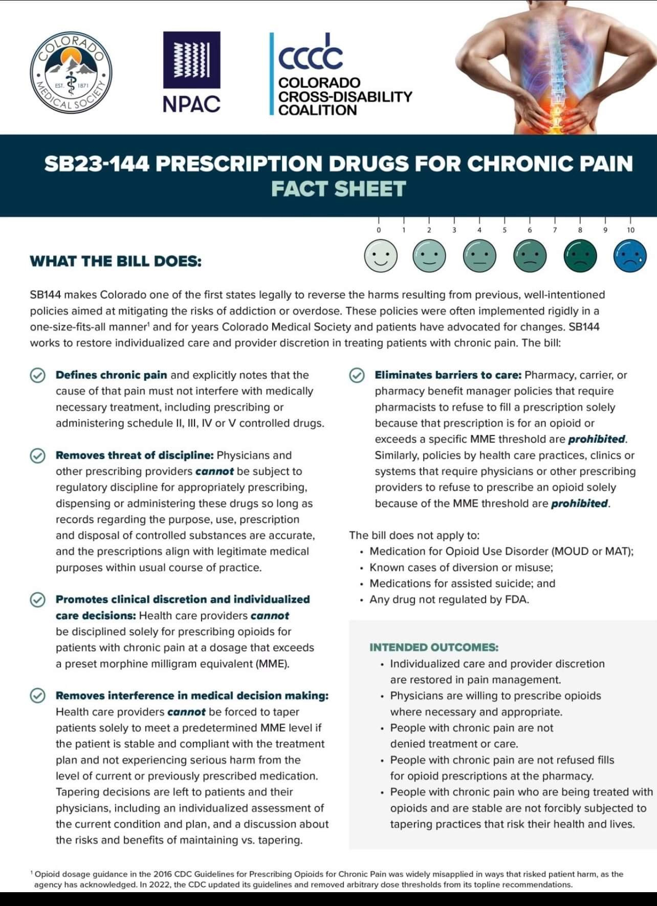
Some States Are Protecting Doctors With Legislation
Defending Doctors in Adversarial Proceedings

Slide 56
States That Protect Doctors With Legislation -2- [*]
Florida, Kentucky, Louisiana, Mississippi, Ohio, and West Virginia “Pill Mill” laws establish regulations for pain management centers but also propose frameworks (sometimes wrong) for legitimate practices.
Connecticut, Delaware, Florida, Hawaii, Indiana, Kentucky, Louisiana, Maine, Maryland, Missouri, Montana, Nebraska, New Jersey, New York, and North Carolina explicitly exempt patients with cancer from opioid prescribing limitations.
California Pain Patient Bill of Rights and Intractable Pain Act.
[*] “When State Legislators Are Given the Opportunity, they Vote Overwhelmingly for Doctor Autonomy in Pain Treatment”
KevinMD.com March 20, 2025
Defending Doctors in Adversarial Proceedings

Slide 57
Arguments in Defense of Clinicians
There is no present accepted consensus “standard of practice” for treating all forms of severe pain.
Certainly not CDC or Veterans Administration guidelines – regardless of whether State guidelines incorporate them, which some still do.
Any testimony relying on CDC, VA, or State guidelines can be challenged on science and ethical grounds (“first do no harm”).
US DEA has no published consensus “standard” that is supported by clinicians.
However, World Health Organization “Analgesic Ladder” offers a practical framework for tailoring therapy to individual patient needs.
Even the diagnostic concept of “opioid use disorder” can be challenged.
The term originated with Diagnostic and Statistical Manual, Version 5.
DSM-5 was repudiated by National Institutes of Health before publication, on grounds of faulty field research. Since updated by DSM-5-TR (March 2022)
Continued use of “OUD” creates confusion in practice guidelines.
“OUD” improperly combines “Addiction”, “Tolerance” and “Dependence” but ignores “Pseudo Addiction”.
“OUD” diagnoses unfairly stigmatize chronic pain patients as addicts or potential addicts
Defending Doctors in Adversarial Proceedings

Slide 58
Hundreds of Papers Contradict CDC Guidelines If you read nothing else, read these:
American Academy of Family Physicians, “Frontline Physicians Call on Politicians to End Political Interference in Evidence Based Medicine”, May 15, 2019 https://www.aafp.org/news/media-center/more-statements/physicians-call-on-politicians-to-end-political-interference-in-the-delivery-of-evidence-based-medicine.html
Lawhern, RA, “An Indictment of Us Public Health Policy on Pain Management” Clinical Medicine and Health Journal, Volume 04, Issue 06, November-December, 2024 Page No. 1031-1036, https://cmhrj.com/index.php/cmhrj/article/view/410/246
Richard A Lawhern PhD, “In Defense of Doctors Who Treat Pain -- Questions and Answers for Judges, Juries... and Journalists” Clinical Medicine and Health Research Journal (CMHRJ) Vol 4, Issue 4, July-August 2024, PP 987-989, https://cmhrj.com/index.php/cmhrj/article/view/379/233
L. Joseph Parker MD, “The Persecution of Pain Management Doctors”, Journal of Medicine, National Association of Medical Doctors, August 23, 2023 https://www.namd.org/journal-of-medicine/3104-the-persecution-of-pain-management-doctors.html
Defending Doctors in Adversarial Proceedings

Slide 59
Understanding Medical Definitions - Arguing Your Case Before Jurors or Boards
Dependence is a purely physical outcome, unrelated to addiction
Patients suffer withdrawal symptoms and breakthrough pain if opioids are tapered rapidly after prolonged use.
“Dependence” does not signal near-term or higher risk of addiction!
Tolerance -- patients may need higher doses over time, to generate the same benefits in pain relief. This is an expected and manageable physical outcome of treatment.
Addiction is different: a compulsive pattern of uncontrollable substance use despite negative consequences known to the user.
Pseudo Addiction is a disorder among clinicians intimidated by hostile regulatory environment.
Predisposition to interpret any request for better pain relief as evidence of imminent addiction or possible shamming to obtain opioids for resale.
But addiction caused by treatment is very rare and unpredictable.
Defending Doctors in Adversarial Proceedings

Slide 60
What Is the WHO Analgesic Ladder?
Developed in 1984 for cancer pain, since expanded. Long taught in medical schools.
Treatment moves upward through four levels, adding or changing therapies until pain is managed with acceptable side effects
Level 1: Non-Opioid Analgesics, NSAIDs for mild to moderate pain. 24-hour treatment rather than “as needed”.
Level 2: “Weak” Opioids (Tramadol, Codeine) for persistent pain
Level 3: “Strong” Opioids (Morphine, Hydromorphone, Methadone, Transdermal Patch) for moderate to severe pain
Level 4: Nerve block, Epidurals, PCA Pump, Spinal Stimulators for severe persistent pain.
Overlaid at each level: “ajudivant” treatments, interventional pain medicine, treatments for anxiety or depression.
Tailored to each individual patient on a “trial and observe” basis.
Defending Doctors in Adversarial Proceedings

Slide 61
Understanding The Evidence
Defending Doctors in Adversarial Proceedings

Slide 62
The Following Evidence Is Known to Boards, DEA and Other Law Enforcement
Doctors over-prescribing to patients did not create and are not sustaining the US opioid crisis
Patients in pain treatment and street addicts are different populations
Addicts are medically under-served;
typical pain patient is a woman of middle age;
typical addict is a male in 30s, with a history of unemployment and no insurance.
Accidental drug mortality is now dominated by illicit fentanyl, often mixed with stimulants.
Hospital admissions for drug overdose are dominated by illegal drugs.
Incidence of addiction caused by treatment is too small to measure accurately (~0.5% or less – possibly 0.1% or less).
Great majority of accidental drug-related deaths involve multiple self-administered illegal drugs plus alcohol.
Detected “prescription” drugs may be diverted, but are rarely prescribed to the decedent by a doctor (Commonwealth of Massachusetts ~3%).
Defending Doctors in Adversarial Proceedings

Slide 63
The Evidence: Correlation vs. Cause
“Correlation is not cause” is a well known phrase.
The reverse is not as familiar: “Without correlation, there can be no cause-and-effect”.
There is no correlation between rates of prescribing versus rates of opioid overdose on either a State-By-State or National basis.
Defending Doctors in Adversarial Proceedings

Slide 64
The Concept of Correlation vs. Cause
Variable “Y” = An Asserted Effect
*
*
*
*
*
*
Data Point
*
*
*
*
*
*
*
*
*
*
*
*
Variable “X” = A Proposed Cause
- If “Y is related at all to X,” then data should be “clumped” around a line.
- Strength of relationship is shown by the “spread” of the data (R- Squared).
Defending Doctors in Adversarial Proceedings

Slide 65
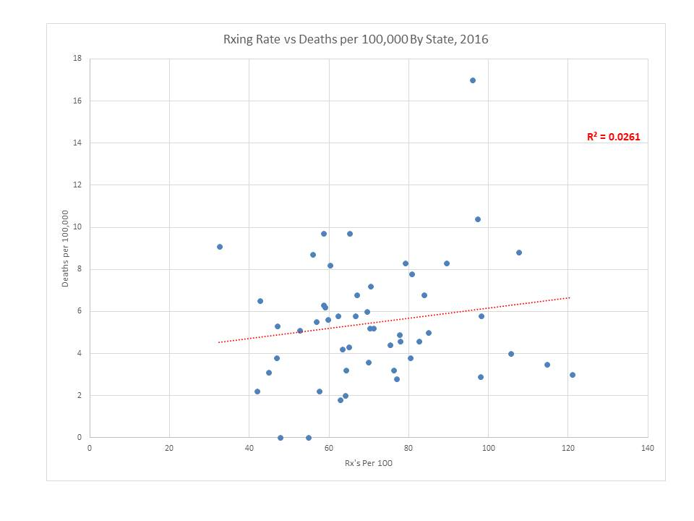

The Evidence: Correlation vs. Cause
Weak or no correlation
US Overdose Deaths versus Rates of Prescriptions, State by State 2016
Defending Doctors in Adversarial Proceedings

Slide 66
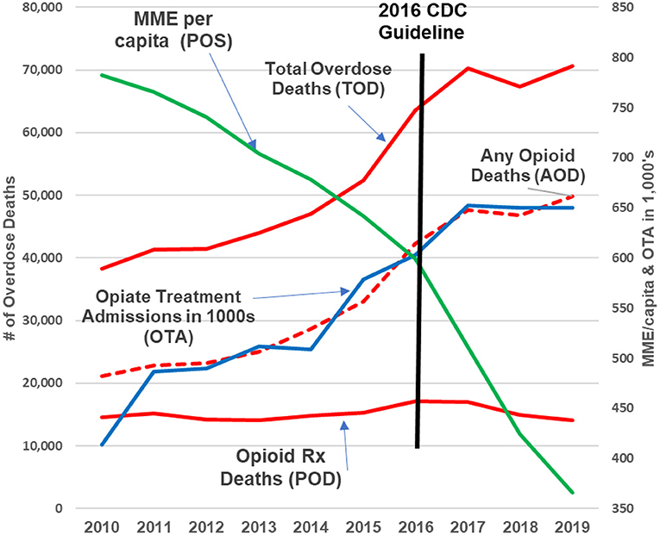
More Evidence: Prescribing vs. Overdose Deaths
US National Overdose Deaths vs. Opioid Volume Prescribed 2010-2019
Defending Doctors in Adversarial Proceedings

Slide 67
More Evidence: Prescribing vs. Overdose Deaths Figure Legend (Top-Down)
Prescribed Volume in Morphine Milligram Equivalents
Total Overdose Deaths
Opioid Deaths From Other than Prescriptions
Hospital Admissions for Opioid Overdose Treatment
Opioid Deaths Involving Prescriptions
Prescribing volume dropped 55% over nine years
All opioid deaths rose ~100%
Prescription-involved opioid deaths were basically constant
Hospital admissions were dominated by illegal drugs
Negative correlation between prescribing volume and overdose deaths = no cause-and-effect relationship
Defending Doctors in Adversarial Proceedings

Slide 68
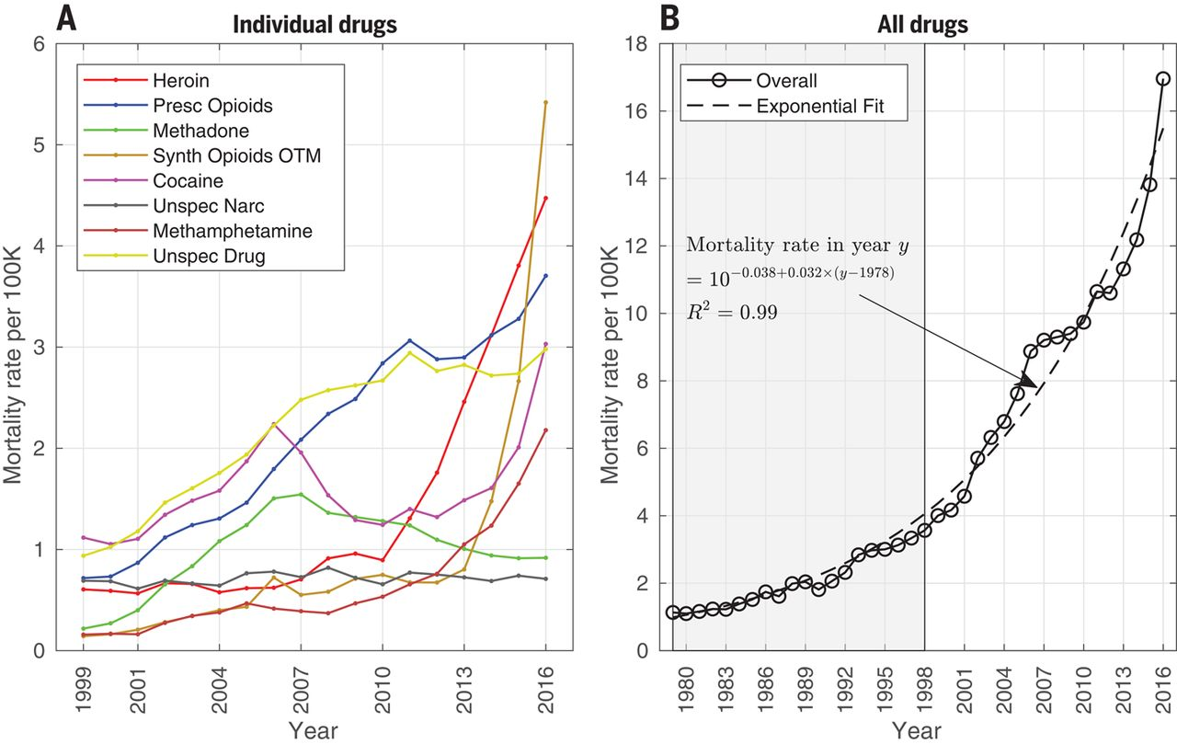
More Evidence: Accidental Drug Overdose Deaths
Defending Doctors in Adversarial Proceedings

Slide 69
Accidental Drug Overdose Deaths 1979-2016
Highly dynamic changes -- exponential curve for 37 years
Eight contributing factors, with overlaps
“Prescription opioids” never contributed more than 22%, and currently appear in under 14% of mortality reports [*]
Before 2018, “synthetic opioids” included both illegal and prescription Fentanyl –> distorted mortality statistics
“Unspecified drugs” and “unspecified narcotics” contribute uncertainty in ~22% of drug-involved deaths
Prescription drugs appear at the margins of accidental overdose deaths… but have never dominated the crisis.
[*] State Unintentional Drug Overdose Reporting System, US CDC, 2024
Defending Doctors in Adversarial Proceedings

Slide 70
Recent Accidental Drug Overdose Deaths
CDC State Unintentional Drug Overdose Reporting System (SUDORS) 2020-2024
Refined cause-of-death attributions
Updated/expanded definition of “Prescription Drugs”
Illegal Fentanyl distinguished from prescribed Fentanyl
Death reports identified involving 14 specific drug categories
Major overlaps identified between opioids and stimulants (cocaine, meth) – almost entirely among street addicts
43 jurisdictions, ~66% of US population so far
See next page for statistics
Defending Doctors in Adversarial Proceedings

Slide 71
Accidental Drug Overdose Deaths 2024 (SUDORS)
Drug or drug class | Number of deaths | Percent of OD deaths
Any Opioids | 39,147 | 73.4%
Illegally-made Fentanyls | 34,748 | 65.1%
Heroin | 3,093 | 5.8%
Prescription Opioids | 7,301 | 13.7%
Any Stimulants | 34,723 | 65.1%
Cocaine | 17,866 | 33.5%
Methamphetamine | 18,523 | 33.5%
Benzodiazepines | 5,899 | 11.1%
Non-opioid Sedatives | 13,039 | 24.4%
Compare
SUDORS Data for 43 US jurisdictions, ~66% of US population, 2024
Defending Doctors in Adversarial Proceedings

Slide 72
Accidental Drug Mortality Rates, 2024
In 2024, prescription drugs were involved as one of several factors, in 13.7% of accidental overdose deaths
2024 death rate involving prescription drugs was 24 per hundred thousand population
Death rates from other causes were hugely larger
Overall death rates = 722 / 100K population per year
Heart Disease = 167 / 100K
Cancer = 183 / 100K
Conclusion: deaths involving prescription drugs are a tragedy -- but not an “epidemic”
Doctors prescribing to pain patients didn’t create the opioid crisis and aren’t placing their patients at risk now by prescribing opioid analgesics.
Defending Doctors in Adversarial Proceedings

Slide 73
Understanding “Risk” in Clinical Literature
“Risk” applies only among large populations – it cannot be calculated for individuals. Risk answers the question “what are the odds that…”
Published “risk” estimates inform doctors when a particular patient may need closer monitoring or additional support and assistance.
Risk estimates help doctors know what to look for in their patients.
BUT! …. “risk” numbers are not reliably predictive in individual cases… and never ever justify denial of care.
It is now known definitively that near-term “risk” of drug overdose or suicide events in patients treated with opioid pain relievers are not driven by prescribing.
Defending Doctors in Adversarial Proceedings

Slide 74
Understanding “Risk” --2--
A Key Study: Elizabeth M Oliva, et al, “Development and Applications of the Veterans Health Administration’s Stratification Tool for Opioid Risk Mitigation (STORM) to Improve Opioid Safety and Prevent Overdose and Suicide”.
1.1 Million Veterans Administration patient records, 2010-2011, for patients treated with opioid analgesics
Highly accurate predictive risk model for next-year overdose or suicide events
Not a prediction for risk of “substance use disorder” (see other sources)
Over 50 factors in patient history analyzed
Overall incidence of overdose or suicide events ~2%
Too small to confidently predict bad patient outcomes in individuals
Large enough to “flag” some patients for stronger oversight and support
Defending Doctors in Adversarial Proceedings

Slide 75
Understanding “Risk” -3-
Elizabeth M Oliva, et al,* Extract From Table 1 - Odds Ratios for Risk
Variable in Patient History | Number of OD or Suicide Events | Odds Ratio (Relative Risk)
Overdose or Suicide Event (Past) | 3,879 | 23.1
Detoxification | 640 | 18.5
Inpatient Mental Health Treatment | 6,769 | 16.6
Sedative Use Disorder | 809 | 11.2
Opioid Use Disorder | 2,779 | 8.0
Stimulant Use Disorder | 4,613 | 8.1
3 Classes of Sedating Pain Meds | 562 | 6.1
Bi-Polar Disorder | 4,276 | 5.8
Other Mental Health Disorder | 19,571 | 5.7
* (see references)
Defending Doctors in Adversarial Proceedings

Slide 76
Understanding “Risk” -4-
A Second Key Study -- Gabriel A Brat, et al: “Postsurgical prescriptions for opioid naive patients and association with overdose and misuse: retrospective cohort study,” 2018
Records of 37,651,619 commercially insured patients 2008 to 2016.
Included 1,015,116 opioid-naive patients who underwent eight types of surgery.
“Misuse” defined as one of 16 diagnostic codes for opioid dependence, abuse, or overdose.
(However, ‘dependence’ is not abuse.)
Codes for opioid “misuse” were identified in 0.6% (183 per 100,000 person-years)
Too small to reliably predict and well within diagnostic confounds
Total duration of opioid use was believed by authors to be the strongest indicator of abuse.
However, total use duration also tracked strongly with known failure rates of common classes of surgical procedures.
Defending Doctors in Adversarial Proceedings

Slide 77
About Opioids and Benzodiazepine Drugs
US CDC and VA guidelines caution against co-prescription of opioid pain relievers and Benzodiazepine anti-anxiety agents.
However, many patients in chronic pain become highly anxious or depressed.
Benzodiazepine drugs are used to treat anxiety and depression.
Some reports indicate higher mortality in patients treated with both opioids and Benzo drugs.
This higher mortality may result from UNDER-treatment of pain, rather than over-treatment.
When patients die while under treatment, opioids are most likely “innocent bystanders”.
Defending Doctors in Adversarial Proceedings

Slide 78
Other Legal Precedents – Public Nuisance Laws
A public nuisance is “any act, condition, or thing that unlawfully interferes with the rights of the public or obstructs the public in enjoying common rights. This includes actions that endanger public health or safety….”
Multiple US courts have found that prescription opioids are not a “public nuisance.” Pharma companies may not be prosecuted on that basis.
People v. Purdue Pharma L.P., No. 30-2014-00725287, 2021 Cal. Super. LEXIS 31743 (Dec. 14, 2021); State ex rel. Hunter v. Johnson & Johnson, 499 P.3d 719, 721, 726 (Okla. 2021) Court held that “Oklahoma public nuisance law does not extend to the manufacturing, marketing, and selling of prescription opioids.”
It can be argued that - absent any objective evidence of specific harms - prescription of opioid analgesics by clinicians is not inherently injurious to any patient at any dose.
No published evidence proves patient harms are increased by higher doses.
Much evidence that patient harms increased by under-treatment of pain.
Defending Doctors in Adversarial Proceedings

Slide 79
Public Nuisance Laws -2-
November 20, 2021: ”Orange, Los Angeles, and Santa Clara counties, joined by the city of Oakland, argued that the companies they sued created a "public nuisance" by encouraging increased use of their products through a false or misleading marketing campaign. The four jurisdictions sought more than $50 billion in damages. Following a bench trial that began on April 19 and wrapped up at the beginning of [October 2021], Wilson concluded that the plaintiffs had failed to prove any of their allegations.”
Court also found that the studies on which expert witness Dr. Anna Lembke relied to claim a 25% addiction rate among opioid patients were "inadequate to support it.” Judge noted that more reliable data suggested an addiction rate of less than 5%
Other published sources (Brat) suggest S.U.D or “addiction” rates are less than 1 patient in 1,000
Defending Doctors in Adversarial Proceedings

Slide 80
Other Legal Precedents -2-
City of Huntington v. AmerisourceBergen Drug Corp., No. 3:17-cv-01362, 2022 U.S. Dist. LEXIS 117322 (S.D. W.Va. July 4, 2022)
County of Lake v. Purdue Pharma (In re Nat’l Prescription Opiate Litig.), No. 1:17-md-2804 (N.D. Ohio Nov. 23, 2021); In re Opioid Litig., No. 400000/2017 (N.Y. Sup. Ct.); County of Suffolk v. Purdue Pharma L.P., No. 400001/2017 (N.Y. Sup. Ct.); County of Nassau v. Purdue Pharma L.P., No. 400008/2017 (N.Y. Sup. Ct.); State v. Purdue Pharma L.P., No. 400016/2018 (N.Y. Sup. Ct.).
HOWEVER NOTE:
Not all courts have agreed with these precedents (see references)
Defending Doctors in Adversarial Proceedings

Slide 81
Observations Concerning Appeals
Appeals of court convictions can be very difficult:
Federal Rule of Criminal Procedure 29: A defendant must show that “the evidence, viewed in the light most favorable to the government, could not have persuaded any trier of fact of the defendant’s guilt beyond a reasonable doubt.” United States v. Merlino, 592 F.3d 22, 29 (1st Cir. 2010).
“The court need not be convinced that the verdict is correct; it need only be satisfied that the verdict is supported by the record.” United States v. Kilmartin, 944 F.3d 315, 325 (1st Cir. 2019).
Conclusion: lawyers should seek to win the initial court case. The deck is stacked against your client in any judicial review.
Defending Doctors in Adversarial Proceedings

Slide 82
Grounds for Successful Appeal
Misapplication of the law, improper jury instructions, or incorrect rulings on evidence admissibility.
Insufficient evidence: When the evidence presented at trial is not enough to support a guilty verdict beyond a reasonable doubt.
Ineffective assistance of counsel: If the defense attorney's performance was deficient and prejudiced the defendant's case
Juror misconduct: This involves improper behavior by jurors during deliberations or the trial, such as unauthorized experiments or communications.
Prosecutorial misconduct: This includes using improper arguments, withholding exculpatory evidence, or engaging in unethical behavior during the trial.
Constitutional violations: When the conviction violates the U.S. Constitution or the state constitution
Abuse of discretion by the lower court: If the trial court made an errant ruling that significantly affected the case's outcome
Defending Doctors in Adversarial Proceedings

Slide 83
Closing Arguments for Lawyers
Defending Doctors in Adversarial Proceedings

Slide 84
Closing Arguments: Summing Up
There are presently no US national consensus standards for “authorized” practice in pain medicine at either State or Federal level.
CDC and Veterans Administration Guidelines are not accepted consensus standards
DEA and DoJ have no published clinical practice standards. They aren’t doctors.
Many State laws now include major errors harmful to patients and clinicians
The least harmful and most practical guidelines for practice of pain medicine might be 40 years old! See the World Health Organization Analgesic Ladder.
Morphine Milligram Equivalent Dose (MMED) is a Mythology, not a Metric
No published large scale trials account for variable metabolism (genetics)
Different MMED models generate different estimates
Many patients thrive on high opioid doses for long periods (over 2,000 MMED!)
Co-prescription of opioids and benzodiazepine drugs may benefit many patients who suffer from both pain and anxiety
Non-consensual or rapid tapering of opioid dose is actively dangerous to patients
Even the concept of “opioid use disorder” is challengeable on science
Government “expert witnesses” aren’t experts if everything they think they know is wrong on science or assumes defendant’s guilt without proof of actual and reliably knowable patient harms.
Defending Doctors in Adversarial Proceedings

Slide 85
Closing Arguments: Summing Up -2-
Clinical prescribing does not “cause” patient addiction or deaths!
US opioid crisis is driven almost entirely by illegal street drugs that pain doctors don’t prescribe and properly treated patients don’t need.
Incidence of addiction caused by medical treatment is too small to reliably diagnose or predict in individuals.
Reliable risk predictors for bad patient outcomes in pain treatment are known…
… and have little to do with opioid prescribing in ongoing patient-doctor relationships....
High levels of prescribing do not signal a pill mill operator or even a “careless” doctor, if patients are regularly seen in person!
More than half of all community clinics are turning away new patients asking for pain management. Remaining doctors have huge patient loads.
AMA says “high prescriber” letters from Prescription Drug Monitoring Programs are violations of legal due process.
Most “red flags” used by pharmacies to reject legitimate prescriptions are nonsense.
Defending Doctors in Adversarial Proceedings

Slide 86
Cautionary Remarks for Defendants
Some attorneys are lazy or greedy
They might not do their homework before going into court
They might “pile on” billable time for dubious purposes
Can you afford $350 to $1,000 dollars per hour?
Some attorneys are incompetent or inexperienced
Before paying a retainer, ASK: “how many cases like mine have you successfully defended?
OR: “how many cases of other lawyers have you successfully appealed?
ASK: “have any of your former clients appealed on grounds of inadequate representation by one your lawyers?”
ASK: “how many self-study hours are you willing to expend to successfully defend me without causing my bankruptcy?”
Defending Doctors in Adversarial Proceedings

Slide 87
CME/CLE Ongoing Educational Resources - Check for Updates -
Author Page, KevinMD – America’s most widely read and cited healthcare newsletter: https://kevinmd.com/post-author/richard-a-lawhern
Protect People in Pain -- An ongoing repository of papers: https://www.reddit.com/r/ProtectPeopleInPain/hot/
European Society of Medicine Author Search Page: https://esmed.org/?s=Lawhern
Perplexity Search Engine: https://www.perplexity.ai/
Google Scholar Citations: https://scholar.google.com/citations?user=IhMnBsAAAAAJ&hl=en
Defending Doctors in Adversarial Proceedings

Slide 88
References
Strongly recommended reading for both lawyers and defense expert witnesses.
Read first for titles.
For depth, investigate key references within the references….. Consider introducing as exhibits in Board Cases
Or
Have expert witnesses summarize for judges and juries.
Defending Doctors in Adversarial Proceedings

Slide 89
References
Richard A. Lawhern, Ph.D. “The Real Opioid Crisis in Three Charts – An FDA Listening Session”, posted to Linked In July 25, 2024, https://www.linkedin.com/pulse/real-opioid-crisis-three-charts-fda-listening-session-lawhern-qkc4c/
Richard A. Lawhern, “Oversight on Revision of US CDC Guidelines: A Process Pre-Destined to Fail” Nursing and Hospital Care, ISSN 2639-9474 16 October 2023, V023; 7(5) pp 1-10 https://www.scivisionpub.com/pdfs/oversight-on-revision-of-us-cdc-opioid-guidelines-a-process-pre-destined-to-fail-2988.pdf?fbclid=IwAR29QSjcNr14RK9H9tFIRHe9BqGHrpnTyC0Ac1H--w5xIMlR2r5yUR144hk
American Academy of Family Physicians, “Frontline Physicians Call on Politicians to End Political Interference in Evidence Based Medicine”, May 15, 2019 https://www.aafp.org/news/media-center/more-statements/physicians-call-on-politicians-to-end-political-interference-in-the-delivery-of-evidence-based-medicine.html
L. Joseph Parker MD, “The Persecution of Pain Management Doctors”, Journal of Medicine, National Association of Medical Doctors, August 23, 2023 https://www.namd.org/journal-of-medicine/3104-the-persecution-of-pain-management-doctors.html
Richard A. Lawhern, “Everything the Government Thinks It Knows About the Opioid Crisis is Wrong”, KevinMD, July 1, 2023 https://www.kevinmd.com/2023/07/everything-the-government-thinks-it-knows-about-the-opioid-crisis-is-wrong.html
Defending Doctors in Adversarial Proceedings

Slide 90
References 2
6. State of Utah Department of Medicaid, “Opioid Oral Morphine Milligram Equivalent (MME) Conversion Factors’, undated, post 2017, https://medicaid.utah.gov/Documents/files/Opioid-Morphine-EQ-Conversion-Factors.pdf
7. Steven E Nadeau MD and Richard A Lawhern, PhD, “The Two Opioid Crises – Problems, Causes, and Potential Solutions: An Analytic Review”, Medical Research Archives of the European Society of Medicine, December 31, 2023 https://esmed.org/MRA/mra/article/view/4846/99193547539
8. American Medical Association “Status - Implementation of Resolutions and Report Recommendations AMA House of Delegates Interim Meeting - November 10-13, 2018” Monday June 3, 2019. https://www.ama-assn.org/system/files/2019-06/i18-status-implementation.pdf
9. Nora Volkow and A Thomas McMillan, “Opioid Abuse in Chronic Pain -- Misconceptions and Mitigation Strategies”, New England Journal of Medicine, March 31, 2016 http://www.nejm.org/doi/full/10.1056/NEJMra1507771
10 . Cathleen London (2021) “DOJ Overreach: The Criminalization of Physicians,” Journal of Legal Medicine, 41:3-4, 191-203, DOI: 10.1080/01947648.2022.2147366.
https://doi.org/10.1080/01947648.2022.2147366
Defending Doctors in Adversarial Proceedings

Slide 91
References 3
11. Jeffrey Miron, Greg Sollenberger, and Laura Nicolae, “Overdosing on Regulation – How The Government Caused the Opioid Epidemic”, Cato Institute, February 14, 2019, https://www.cato.org/policy-analysis/overdosing-regulation-how-government-caused-opioid-epidemic#
12. Larry Aubry and B. Thomas Carr, “Overdose, opioid treatment admissions and prescription opioid pain reliever relationships: United States, 2010–2019” Frontiers in Pain Research, Volume 3 - 2022 https://doi.org/10.3389/fpain.2022.884674
13. Nadeau SE, Wu JK, Lawhern RA, “Opioids and Chronic Pain: An Analytic Review of the Clinical Evidence” Frontiers in Pain Research, Front. Pain Res., 16 August 2021 https://www.frontiersin.org/journals/pain-research/articles/10.3389/fpain.2021.721357/full
14. Jalal H, Buchanich JM, Roberts MK, et al, “Changing Dynamics of the Drug Overdose Epidemic in the United States from 1979 through 2016”, Science, 21 September 2018, https://www.science.org/doi/10.1126/science.aau1184
15. Singer JA, Sullum JZ, Schatman ME, “Today’s nonmedical opioid users are not yesterday’s patients; implications of data indicating stable rates of nonmedical use and pain reliever use disorder” Journal of Pain Research, v.12; pp 617-620, 2019, https://www.ncbi.nlm.nih.gov/pmc/articles/PMC6369835/#:~:text=The%20rising%20incidence%20of%20drug,mixtures%20have%20become%20more%20reckless.
16. Lawhern RA, “Doctors Diagnosing Addiction – Are the Blind Leading the Blind?” Medical Research Archives of the European Society of Medicine, Nov 30, 2023, https://esmed.org/MRA/mra/article/view/4726/99193547448
Defending Doctors in Adversarial Proceedings

Slide 92
References 4
17. Lawhern RA “How Biased Medical Experts Are Destroying Doctors’ Lives and Careers In The Opioid Crisis”, KevinMD, Sep 12, 2024, https://esmed.org/MRA/mra/article/view/4726/99193547448
18. Monty Goddard, “A Two-Headed Monster – State Attorneys General and the Drug Enforcement Agency”, Daily Remedy, November 12, 2023, https://www.daily-remedy.com/a-two-headed-monster-state-attorneys-general-and-the-drug-enforcement-agency/
19. Pat Irving, RN, “The National Opioid Settlement is Causing Drug Shortages”, Pain News Network, September 11, 2023. https://www.painnewsnetwork.org/stories/2023/9/11/the-national-opioid-settlement-is-causing-drug-shortages
20. Oliva EM, Bowe T, Tavicoli S, et al, “Development and Applications of the Veterans Administrations Stratification Tool for Opioid Risk Mitigation (STORM) to Improve Opioid Safety and Prevent Overdose and Suicide” Veterans Administration Psychological Services 2017, V. 14, No. 1, pp. 34-49 https://www.apa.org/pubs/journals/features/ser-ser0000099.pdf
21 . Monty Goddard, “A Two-Headed Monster – State Attorneys General and the Drug Enforcement Agency”, Daily Remedy, November 12, 2023, https://www.daily-remedy.com/a-two-headed-monster-state-attorneys-general-and-the-drug-enforcement-agency/
22. Pat Irving, RN, “The National Opioid Settlement is Causing Drug Shortages”, Pain News Network, September 11, 2023. https://www.painnewsnetwork.org/stories/2023/9/11/the-national-opioid-settlement-is-causing-drug-shortages
Defending Doctors in Adversarial Proceedings

Slide 93
References 5
23. Grace Chai, PharmD, “Morphine Milligram Equivalents (MMEs) - Current Applications and Knowledge Gaps, Research Opportunities, and Future Directions” FDA Office of Surveillance and Epidemiology, Workshop June 7-8, 2021 https://www.fda.gov/media/150436/download
24. Michael E Schatman PhD, Jeffrey Fudin PharmD, “The Myth of Morphine Equivalent Daily Dosage” Medscape, May 24, 2016, https://www.medscape.com/viewarticle/863477?form=fpf
25. Stephen A. Martin, MD, EdM; Ruth A. Potee, MD, DABAM; and Andrew Lazris, MD “Neat, Plausible, and Generally Wrong: A Response to the CDC Recommendations for Chronic Opioid Use” September 7, 2016, Medium, https://medium.com/@stmartin/neat-plausible-and-generally-wrong-a-response-to-the-cdc-recommendations-for-chronic-opioid-use-5c9d9d319f71#.wzchd1kkl 26. Cunningham C. “Observations of the Opioid Workgroup of the Board of Scientific Counselors of the National Center for Injury Prevention and Control on the Updated CDC Guideline for Prescribing Opioids. 2021.” https://www.cdc.gov/injury/pdfs/bsc/OWG-Report-of-Recs-1-12-06.30.21-FINAL-508.pdf
27. American Association For Thoracic Surgery, “Statement on The Physician Acting As An Expert Witness”, May 2008, https://www.aats.org/about-the-aats/governance/statement-on-the-physician-acting-as-an-expert-witness
Defending Doctors in Adversarial Proceedings

Slide 94
References 6
28. Angela Coppelino JD, “When is a Treating Physician Considered an Expert Witness?” Expert Institute, December 20, 2022 https://www.expertinstitute.com/resources/insights/when-is-a-treating-physician-considered-an-expert-witness/
29 Angela Coppelino JD, “The Daubert Standards” , Expert Institute, August 12, 2024, https://www.expertinstitute.com/resources/insights/the-daubert-standard-a-guide-to-motions-hearings-and-rulings/
30. Bai, DS, “The Expert Witness in Medical Malpractice Litigation”, Clinical Orthopedics Related Research, 2009; Feb, V467(2) pp 383-391, https://www.ncbi.nlm.nih.gov/pmc/articles/PMC2628518/
31. Legal Information Institute, Cornell Law School, “Rule 702. Testimony By Expert Witnesses” 2023, https://www.law.cornell.edu/rules/fre/rule_702
32. Legal Information Institute, Cornell Law School, “Rule 701. Opinion Testimony By Lay Witnesses” 2023, https://www.law.cornell.edu/rules/fre/rule_701 33. Richard A Lawhern PhD, “In Defense of Doctors Who Treat Pain--Questions and Answers for Judges, Juries... and Journalists” Clinical Medicine and Health Research Journal (CMHRJ) Vol 4, Issue 4, July-August 2024, PP 987-989, https://cmhrj.com/index.php/cmhrj/article/view/379/233
Defending Doctors in Adversarial Proceedings

Slide 95
References 7
34. Richard A Lawhern PhD, “Everything the Government Thinks It Knows About the Opioid Crisis is Wrong”, KevinMD, July 1, 2023, https://www.kevinmd.com/2023/07/everything-the-government-thinks-it-knows-about-the-opioid-crisis-is-wrong.html
35. Lashley and Baer PC, Attorneys at Law, “To Convict Doctors for Illegally Prescribing Controlled Substances, Government Must Prove They Did So Knowingly or Intentionally, U.S. Supreme Court Holds” https://www.lashlybaer.com/to-convict-doctors-for-illegally-prescribing-controlled-substances-government-must-prove-they-did-so-knowingly-or-intentionally-u-s-supreme-court-holds/ Accessed October 8, 2024
36. World Health Organization, “WHO Guidelines for the pharmacological and radiotherapeutic management of cancer pain in adults and adolescents” ISBN: 978 92 4 155039 0 https://www.who.int/publications/i/item/9789241550390
37. Stephen E Nadeau MD and Richard A Lawhern PhD “Management of Chronic Non-Cancer Pain: A Framework”, Pain Management, 01 June 2022, pp 751-777, https://www.tandfonline.com/doi/full/10.2217/pmt-2022-0017
38. Richard A. Lawhern, PhD and Stephen E Nadeau MD, “Treating Pain and Anxiety –A Modest Proposal” Medical Research Archives of the European Society of Medicine, June 24, 2024, https://esmed.org/MRA/mra/article/view/5359/
Defending Doctors in Adversarial Proceedings

Slide 96
References 8
39. Stephen E Nadeau, Natalie J. DelRocco, and Samuel S. Wu, “Opioid Trials: Time for a New Approach? Enriched Enrollment Randomized Gradual Withdrawal Designs” Pain Management 2022 April 12(3):243-247 https://pubmed.ncbi.nlm.nih.gov/35001667/
40. Richard A Lawhern PhD and Stephen E Nadeau MD, “Behind the AHRQ Report: Understanding the limitations of “non-pharmacological, non-invasive” therapies for chronic pain ´ Practical Pain Management, October 3, 2018, https://www.medcentral.com/pain/behind-ahrq-report
41. Stephen E Nadeau MD and Richard A Lawhern PhD, “Opioids: Analgesia, Euphoria, Dysphoria, and Oblivion: Observations and a Hypothesis” Medical Research Archives of the European Society of Medicine, June 30, 2024, https://esmed.org/MRA/mra/article/view/5411/99193548017
42. Richard A. Lawhern PhD. “Figures Lie and Liars Figure – Why the Demographics of the So-Called “Prescription Opioid Crisis” Don’t Work, PainDoctor – The Blog of Jeffrey Fudin, DPharm, November 17, 2017, https://paindr.com/figures-lie-and-liars-figure-why-the-demographics-of-the-so-called-prescription-opioid-crisis-dont-work/
43. Gery P Guy and Kun Zhang, “Opioid Prescribing by Specialty and Volume in the US”, Am J Prev Med. 2018 Sep 12;55(5):e153–e155. doi: 10.1016/j.amepre.2018.06.008
44. Vaegter HB, Stoeten M et al, “Cause-specific mortality of patients with severe chronic pain referred to a multidisciplinary pain clinic: a cohort register-linkage study” De Cruyter, September 6, 2018, https://www.degruyter.com/document/doi/10.1515/sjpain-2018-0094/html
Defending Doctors in Adversarial Proceedings

Slide 97
References 9
45. Tennant F. Sudden, “Unexpected Death in Chronic Pain Patients.” Pract Pain Manag. 2012;12(5). https://www.medcentral.com/pain/chronic/sudden-unexpected-death-chronic-pain-patients
46. Webb S, Roberts A-O, et al, “Mortality of Adults with Chronic Non-Cancer Pain: A Systematic Review and Meta-Analysis” medRXrv, March 24, 2024, https://www.medrxiv.org/content/10.1101/2024.03.22.24304748v1.full
47. Parker, LJ, “The Shocking Truth Behind the DEA’s Role in America’s Pain Crisis and Doctor Prosecutions”, KevinMD, November 3, 2024, https://kevinmd.com/2024/11/the-shocking-truth-behind-the-deas-role-in-americas-pain-crisis-and-doctor-prosecutions.html
48. Condon PC, Cooper M, Gilbert JD, “Are Opioids a Public Nuisance? It Depends on Whom You Ask” American Bar Association, THE BRIEF, VOLUME 51, NUMBER 4, SUMMER 2022. (Replication requires permission of the ABA)
49. Lawhern, RA, “An Indictment of Us Public Health Policy on Pain Management” Clinical Medicine and Health Journal, Volume 04, Issue 06, November-December, 2024 Page No. 1031-1036, https://cmhrj.com/index.php/cmhrj/article/view/410/246 50. Lawhern RA, “Resources for Clinicians in Pain Medicine: Correcting Medical Mythologies on Prescription of Opioid Analgesics” Medical Research Archives of the European Society of Medicine, December 31, 2023, https://esmed.org/MRA/mra/article/view/4860/99193547580
Defending Doctors in Adversarial Proceedings

Slide 98
References 10
51. Lawhern RA “The Real Cause of the Opioid Crisis Isn’t What You Think:, KevinMD, November 13, 2024, https://kevinmd.com/2024/11/the-real-cause-of-the-opioid-crisis-isnt-what-you-think.html 52. Sullum, J, “A Scathing Rejection of the Case Against Four Drug Companies Highlights Misconceptions About the 'Opioid Crisis‘” Reason Magazine, 11-2-2021, https://reason.com/2021/11/02/a-scathing-rejection-of-the-case-against-four-drug-companies-highlights-misconceptions-about-the-opioid-crisis/
53. Raymond, N, “California Judge Delivers Drugmakers 1st Trial Win in Opioid Litigation” US News, November 1, 2021, © Thompson Reuters, https://www.usnews.com/news/us/articles/2021-11-01/california-judge-rules-for-drugmakers-in-major-opioid-lawsuit
54. Lawhern, R, “An Indictment of US Public Health Policy on Pain Management”, Clinical Medicine and Health Research Journal (CMHRJ) Volume 04, Issue 06, November-December, 2024 Page No. 1031-1036 https://cmhrj.com/index.php/cmhrj/article/view/410/246
55. Lawhern R, “The Real Cause of the Opioid Crisis Isn’t What You Think”, KevinMD, November 13, 2024, https://kevinmd.com/2024/11/the-real-cause-of-the-opioid-crisis-isnt-what-you-think.html
56. FindLaw, “The Basis for a Criminal Appeal” [undated – accessed December 21, 2024] https://www.findlaw.com/criminal/criminal-procedure/the-basis-for-a-criminal-appeal.html
Defending Doctors in Adversarial Proceedings

Slide 99
References 11
57. Rutkow L, Vernick JS, and Alexander GC, “More States Should Regulate Pain Management Clinics to Promote Public Health” Am J Public Health. 2017 Feb;107(2):240–243, doi: 10.2105/AJPH.2016.303568 https://pmc.ncbi.nlm.nih.gov/articles/PMC5227936/
58. Title, California Code of Regulations, Section 70707, https://calhospital.org/file/patient-rights/, accessed December 21, 2024
59. State of California, AB 507 Controlled Substances – Pain Management (2011-2012), https://leginfo.legislature.ca.gov/faces/billCompareClient.xhtml?bill_id=201120120AB507 60. Richard A Lawhern, PhD “Why Chronic Pain Patients and Doctors are both Under Attack", KevinMD, August 21, 2025 . https://kevinmd.com/2025/08/why-chronic-pain-patients-and-doctors-are-both-under-attack.html
61. Richard A. Lawhern PhD, “The FDA is Talking When They Should Be Listening – Part 2”, AJMCRR. 2025;4(9): 1-3. 05 September 2025, https://ajmcrr.com/index.php/pub/article/view/347/355 63. Richard A. Lawhern, PhD., “2022 Clinical Practice Guidelines on Prescribing Opioids for Pain”, DC-Engage and US District of Columbia Department of Health, May 7, 2025, https://ehealthhiv.org/course/view.php?id=609
Defending Doctors in Adversarial Proceedings

Slide 100
References 12
64. Richard A. Lawhern, PhD. “Comprehensive, Evidence-Based, Consensus Guidelines for Prescription of Opioids for Chronic Non-Cancer Pain from the American Society of Interventional Pain Physicians (ASIPP)”, Harm Reduction Learning Institute, from HealthHIV, July 25, 2025, https://reduceharmdc.org/training/guidelines-for-opioids-for-chronic-non-cancer-pain/?eType=EmailBlastContent&eId=1ad4b68a-0e25-444f-b21e-efcf1f62d259
65. Richard A Lawhern, PhD. “Opioid prescribing guidelines ignore metabolism”, KevinMD, November 7, 2025, https://kevinmd.com/2025/11/opioid-prescribing-guidelines-ignore-metabolism.html
66. Richard A. Lawhern, PhD, “Modified DSM-5 Opioid Use Disorder Criteria for Pain Patients” KevinMD, December 1, 2025, https://kevinmd.com/2025/12/modified-dsm-5-opioid-use-disorder-criteria-for-pain-patients.html
Defending Doctors in Adversarial Proceedings

